Slide 1
Error Correcting Codes
CS 161

Slide 2
why error correcting codes
noise in communication channels causes errors
e.g. WiFi, Bluetooth, etc.
sent: 0011 0010 1101
received: 0010 0110 1101
wires in circuits can act like antennas
electromagnetic radiation becomes digital data
single event upset (SEU)
cosmic particles collide with atoms in atmosphere, create showers of ionized particles (neutrons, protons), these can discharge transistors.
the smaller the transistor geometry, the lower the energy needed to keep its state

Slide 3
the Hamming SEC code
Hamming distance
Number of bits that are different between two binary strings
Hd (a, b) = population count (a XOR b)
General case (non binary): edit distance
Given two strings of equal length, it is the minimum number of substitutions required to change one strings into another:
sent OHLALA!
received OHLALU!
edit distance = 1

Slide 4
parity
to binary strings of size n (word),
add one extra bit (parity bit) such that the number of 1’s is always even (even parity)
⇒ the Hamming distance between any two correct words is 2
⇒ if a word has an odd number of 1s, one of its bits is in error
we cannot tell which one though
Minimum distance = 2
provides single bit error detection (parity code)
Minimum distance = 3
provides single error correction, 2 bit error detection

Slide 5
parity bit - SED
Parity bit
is an additional bit set to make the number of 1s even (or odd) in that word
it is a Single Error Detection (SED) mechanism.
in case of an error, the data is re-transmitted or re-fetched from memory.
7-bit data | #1s | 8-bits with parity
 |  | even | odd
0000000 | 0 | 00000000 | 00000001
0001111 | 4 | 00011110 | 00011111
0000111 | 3 | 00001111 | 00001110
1111111 | 7 | 11111111 | 11111110

Slide 6
parity checking
generating a parity bit
checking the parity
b₀
b₁
b₂
b₃
b₄
b₅
b₆
b₇
b₀
b₁
b₂
b₃
b₄
b₅
b₆
b₇
p
∑
p
∑
check bit
error if check bit != 0
two or an even number of errors are not detected

Slide 7
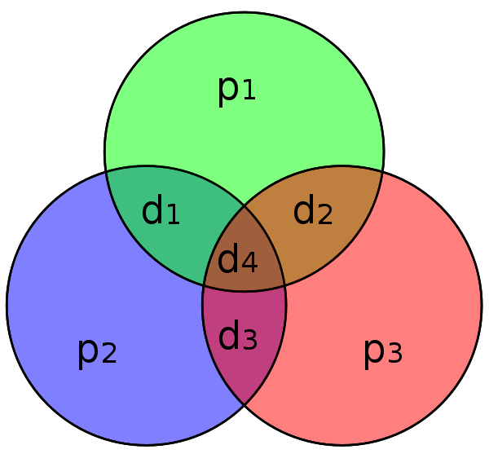
Hamming code [7,4]
Simplest Hamming code:
4 bits of data (d1:d4) and 3 parity bits (p1:p3)
[7,4] means total 7 bits, data is 4 bits
each parity bit covers 3 data bits
the Hamming distance of every encoded word is now 3
so it is possible to detect and correct a single error
but the decoder cannot distinguish between a single-bit error of a code word and the double-bit error of another code word

Slide 8
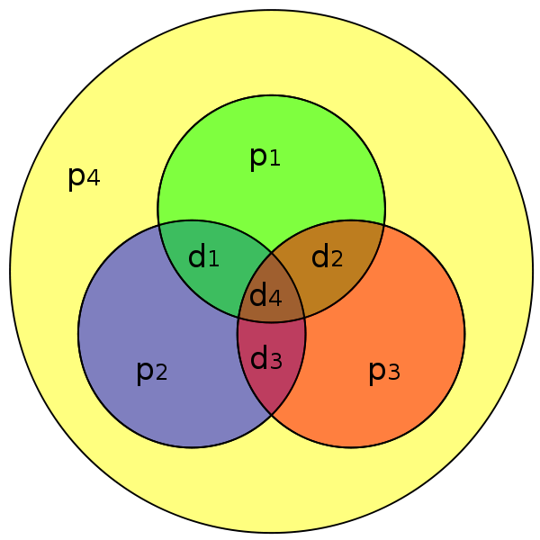
Hamming code [8,4]
Add a parity bit to the whole code word of the [7,4]
increases the Hamming distance to 4
allows SEC/DED
(i.e single error correction or double error detection)

Slide 9
encoding SECDED
Hamming code [12,8]
can achieve Single Error Correction (SEC) and Double Error Detection (DED)
To calculate Hamming code:
Number bits from 1 on the left
All bit positions that are a power 2 are parity bits
Each parity bit covers certain data bits:
Bit 1 (0001) for bits (1, 3, 5, 7, 9, 11, …): XXX1
Bit 2 (0010) for bits (2, 3, 6, 7, 10, 11, 14, 15, …): XX1X
Bit 4 (0100) for bits (4-7, 12-15, 20-23, …): X1XX
Bit 8 (1000) for bits (8-15, 24-31, 40-47, …): 1XXX
Note that each bit is covered by two or more parity bits.
Set parity bits to create even parity for each group.

Slide 10
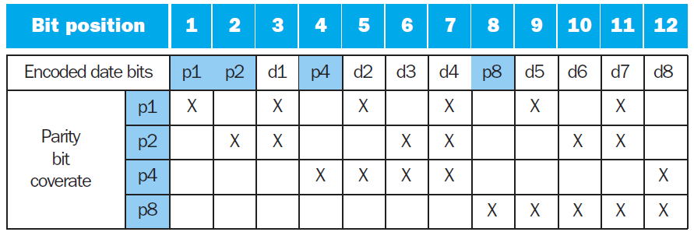
SECDED table [12,8]
 | 1 | 2 | 3 | 4 | 5 | 6 | 7 | 8 | 9 | 10 | 11 | 12
 | p1 | p2 | d1 | p4 | d2 | d3 | d4 | p8 | d5 | d6 | d7 | d8
data
p1
p2
p4
p8
encoded data

Slide 11
decoding SEC (12,8)
Value of parity bits indicates which bits are in error
Use numbering from encoding procedure
Textbook example: value = 10011010 (8 bits)
Encoded value = 011100101010 (12 bits: 8 data + 4 parity)
Parity bits = 0110 indicates no error
Assume bit 3 is flipped: 010100101010
Compute the new parity bits:
P1 - (bits 1,3,5,7,9,11: 0,0,0,1,1,1), Should be 1. ERROR
P2 - (bits 2,3,6,7,10,11: 1,0,0,1,0,1). Should be 0. ERROR
P4 - (bits 4-7, 12: 1,0,0,1,0). CORRECT
P8 - (bits 8-12: 0,1,0,1,0). CORRECT
Parity bits 1 and 2 are in error, 1+2 = 3 ← the bit in error

Slide 12
example
 | 1 | 2 | 3 | 4 | 5 | 6 | 7 | 8 | 9 | 10 | 11 | 12
 | p1 | p2 | d1 | p4 | d2 | d3 | d4 | p8 | d5 | d6 | d7 | d8
data |  |  | 1 |  | 0 | 0 | 1 |  | 1 | 0 | 1 | 0
p1 | 0 |  | 1 |  | 0 |  | 1 |  | 1 |  | 1
p2 |  | 1 | 1 |  |  | 0 | 1 |  |  | 0 | 1
p4 |  |  |  | 1 | 0 | 0 | 1 |  |  |  |  | 0
p8 |  |  |  |  |  |  |  | 0 | 1 | 0 | 1 | 0
encoded data | 0 | 1 | 1 | 1 | 0 | 0 | 1 | 0 | 1 | 0 | 1 | 0

Slide 13
example (2)
Assume bit 3 is flipped
bits 1 and 2 are incorrect
1+2 = 3, the bit position in error
 | 1 | 2 | 3 | 4 | 5 | 6 | 7 | 8 | 9 | 10 | 11 | 12
 | p1 | p2 | d1 | p4 | d2 | d3 | d4 | p8 | d5 | d6 | d7 | d8
encoded data | 0 | 1 | 0 | 1 | 0 | 0 | 1 | 0 | 1 | 0 | 1 | 0
p1 | 0 |  | 0 |  | 0 |  | 1 |  | 1 |  | 1
p2 |  | 1 | 0 |  |  | 0 | 1 |  |  | 0 | 1
p4 |  |  |  | 1 | 0 | 0 | 1 |  |  |  |  | 0
p8 |  |  |  |  |  |  |  | 0 | 1 | 0 | 1 | 0

Slide 14
SEC/DEC code
Add an additional parity bit for the whole word (p_{n})
Make Hamming distance = 4
Decoding:
Let H = SEC parity bits
H even, p_{n} even, no error
H odd, p_{n} odd, correctable single bit error
H even, p_{n} odd, error in p_{n} bit
H odd, p_{n} even, double error occurred
Note:
ECC DRAM uses SEC/DEC with 8 bits protecting each 64 bits, they are 72-bits wide

Slide 15
SEC generalization
Let p number of parity bits, d number of data bits
p parity bits can cover from 1 to (2^{p}– 1) total bits
there are (p+d) possible bit errors and 1 case of no error
so 2^{p} >= p+d+1
so p bits provide SEC for (p+d) bits, one more bit adds DED, so we get SEC/DED
p | d | total bits | name
2 | 1 | 3 | Hamming(3,1)
3 | 4 | 7 | Hamming(7,4)
4 | 11 | 15 | Hamming(15,11)
5 | 26 | 31 | Hamming(31,26)
p | 2^{p} - p - 1 | 2^{p} - 1
d = | 8 | 16 | 32 | 64
p = | 4 | 5 | 6 | 7

Slide 16
example
Min number of parity bits to protect a 128-bit word using the SEC/DED?
9 bits. How?

