Slide 1
CS161 – Design and Architecture of Computer
Virtual Memory

Slide 2
iEval is now open…
iEval is open from the Monday of week nine (May 27th) until (midnight) on the Friday of week ten (June 7th)
You can do it in just a few minutes
The feedback really motivates me and helps me understand how to improve the course
I won’t be able to access results until grades have been submitted, so don’t worry ☺

Slide 3
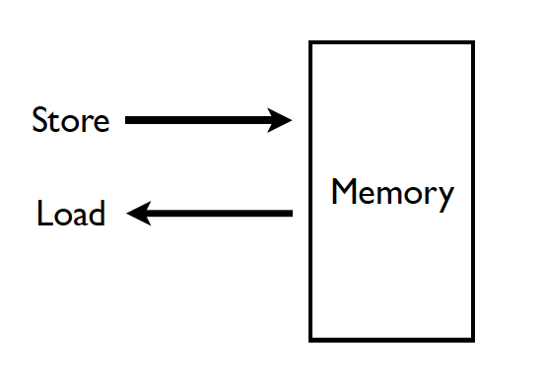
Memory (Programmer’s View)

Slide 4
Abstraction: Virtual vs. Physical Memory
Programmer sees virtual memory
  Can assume the memory is “infinite”
Reality: Physical memory size is much smaller than what the programmer assumes
The system (system software + hardware, cooperatively) maps virtual memory addresses to physical memory
  The system automatically manages the physical memory space transparently to the programmer
+ Programmer does not need to know the physical size of memory nor manage it → A small physical memory can appear as a huge one to the programmer → Life is easier for the programmer
-- More complex system software and architecture
A classic example of the programmer/(micro)architect tradeoff

Slide 5
A System with Physical Memory Only
Examples:
  Early PCs
  Nearly all embedded systems
CPU’s load or store addresses used
directly to access memory
Memory
0:
Physical
Addresses
1:
CPU
N-1:
Notes:
Ask about what are the potential problems? (Size, segmentation, security)

Slide 6
The Problem
Physical memory is of limited size (cost)
  What if you need more?
  Should the programmer be concerned about the size of code/data blocks fitting physical memory?
  Should the programmer manage data movement from disk to physical memory?
  Should the programmer ensure two processes do not use the same physical memory?
Also, ISA can have an address space greater than the physical memory size
  E.g., a 64-bit address space with byte addressability
  What if you do not have enough physical memory?

Slide 7
Virtual Memory
Idea: Give the programmer the illusion of a large address space while having a small physical memory
  So that the programmer does not worry about managing physical memory
Programmer can assume he/she has “infinite” amount of physical memory
Hardware and software cooperatively and automatically manage the physical memory space to provide the illusion
  Illusion is maintained for each independent process

Slide 8
Basic Mechanism
Indirection (in addressing)
Address generated by each instruction in a program is a “virtual address”
  i.e., it is not the physical address used to address main memory
An “address translation” mechanism maps this address to a “physical address”
  Address translation mechanism can be implemented in hardware and software together

Slide 9
A System with Virtual Memory (Page based)
Address Translation: The hardware converts virtual addresses into physical addresses via an OS-managed lookup table (page table)
Memory
0:
Page Table
1:
Virtual
Addresses
Physical
Addresses
0:
1:
CPU
P-1:
N-1:
Disk

Slide 10
Virtual Pages, Physical Frames
Virtual address space divided into pages
Physical address space divided into frames
A virtual page is mapped to
  A physical frame, if the page is in physical memory
  A location in disk, otherwise
If an accessed virtual page is not in memory, but on disk
  Virtual memory system brings the page into a physical frame and adjusts the mapping → this is called demand paging
Page table is the table that stores the mapping of virtual pages to physical frames

Slide 11
Cache vs VM
Cache Virtual Memory
Block or Line Page
Miss Page Fault
Block Size: 32-64B Page Size: 4K-16KB
Placement:
Direct Mapped, Fully Associative
N-way Set Associative
Replacement:
LRU or Random LRU approximation
Write Thru or Back Write Back
How Managed:
Hardware Hardware + Software
(Operating System)

Slide 12
Supporting Virtual Memory
Virtual memory requires both HW+SW support
  Page Table is in memory
  Can be cached in special hardware structures called Translation Lookaside Buffers (TLBs)
The hardware component is called the MMU (memory management unit)
  Includes Page Table Base Register(s), TLBs, page walkers
It is the job of the software to leverage the MMU to
  Populate page tables, decide what to replace in physical memory
  Handle page faults and ensure correct mapping

Slide 13
Page Fault (“A Miss in Physical Memory”)
If a page is not in physical memory but disk
  Page table entry indicates virtual page not in memory
  Access to such a page triggers a page fault exception
  OS trap handler invoked to move data from disk into memory
    Other processes can continue executing
    OS has full control over placement
Before fault
After fault
Memory
Memory
Page Table
Virtual
Addresses
Physical
Addresses
Page Table
Virtual
Addresses
Physical
Addresses
CPU
CPU
Disk
Disk

Slide 14
Page Table is Per Process
Each process has its own virtual address space
  Full address space for each program
  Simplifies memory allocation, sharing, linking and loading.
0
Physical Address
Space (DRAM)
Virtual Address Space for Process 1:
0
Address Translation
VP 1
PF 2
VP 2
...
N-1
(e.g., read/only library code)
PF 7
Virtual Address Space for Process 2:
0
VP 1
VP 2
PF 10
...
N-1
M-1

Slide 15
Performing Address Translation (I)
VM divides memory into equal sized pages
Address translation relocates entire pages
  offsets within the pages do not change
  if page size is a power of two, the virtual address separates into two fields:
  (like cache index, offset fields)
Virtual Page Number
Page Offset
virtual address

Slide 16
Performing Address Translation (II)
Parameters
  P = 2^{p} = page size (bytes).
  N = 2^{n} = Virtual-address limit
  M = 2^{m} = Physical-address limit
n–1
p
p–1
0
virtual page number
page offset
virtual address
address translation
m–1
p
p–1
0
physical frame number
page offset
physical address
Page offset bits don’t change as a result of translation

Slide 17
Performing Address Translation (III)
Separate (set of) page table(s) per process
VPN forms index into page table (points to a page table entry)
Page Table Entry (PTE) provides information about page
page table
base register
(per process)
virtual address
0
n–1
p
p–1
virtual page number (VPN)
page offset
valid
access
physical frame number (PFN)
VPN acts as
table index
if valid=0
then page
not in memory
(page fault)
m–1
p
p–1
0
physical frame number (PFN)
page offset
physical address

Slide 18
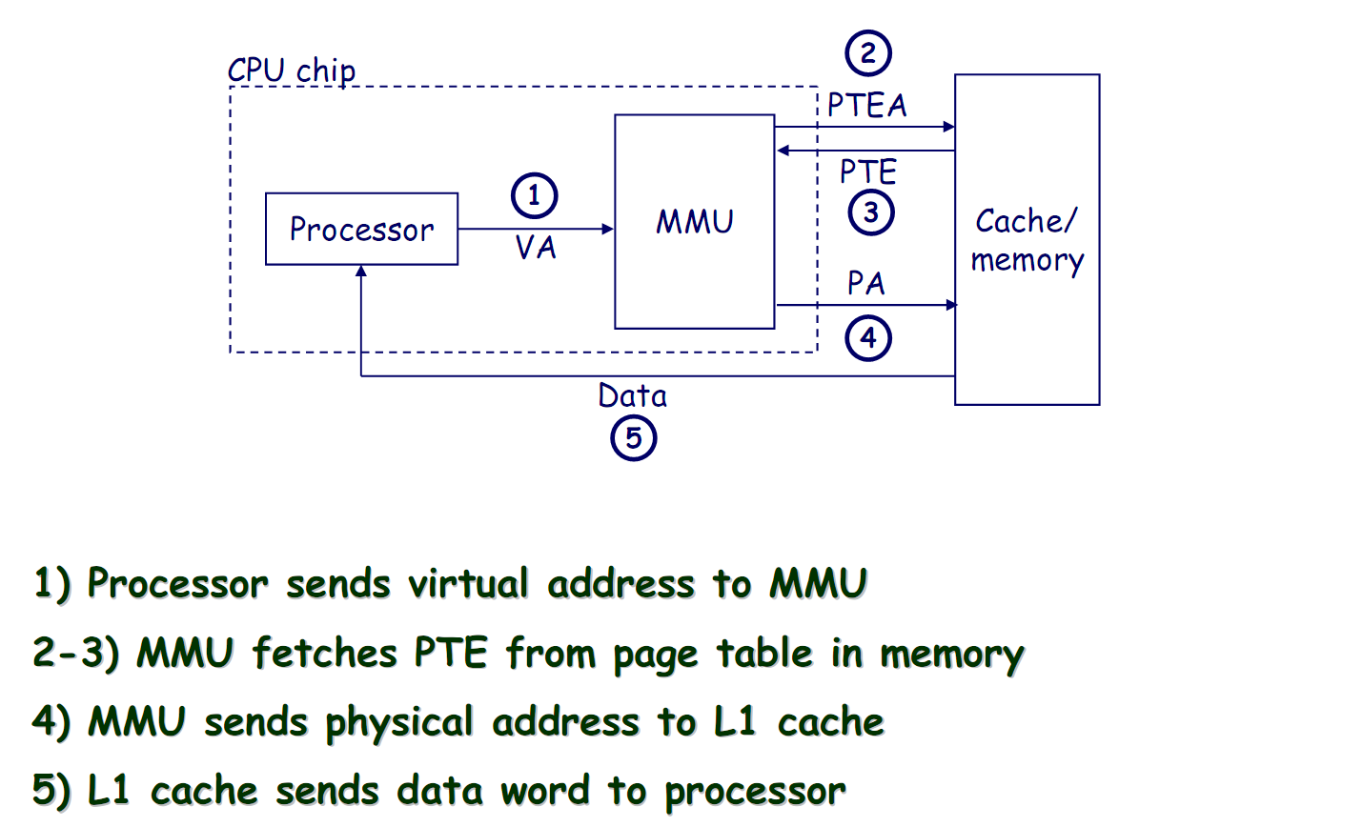
Address Translation: Page Hit

Slide 19
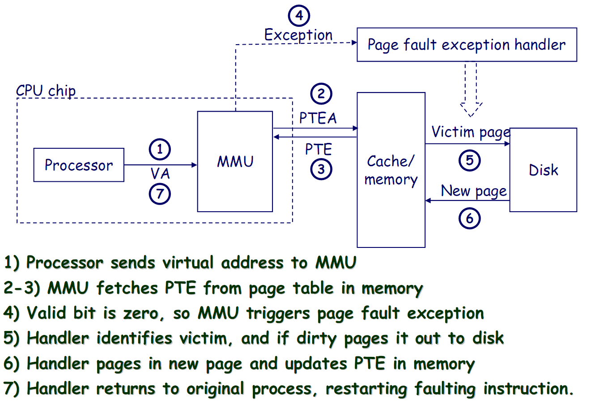
Address Translation: Page Fault

Slide 20
Page-Level Access Control (Protection)
Not every process is allowed to access every page
  E.g., may need supervisor level privilege to access system pages
Idea: Store access control information on a page basis in the process’s page table
Enforce access control at the same time as translation
→ Virtual memory system serves two functions today
Address translation (for illusion of large physical memory)
Access control (protection)

Slide 21
VM as a Tool for Memory Access Protection
Extend Page Table Entries (PTEs) with permission bits
Check bits on each access and during a page fault
  If violated, generate exception (Access Protection exception)
Page Tables
Memory
Read?
Write?
Physical Addr
PF 0
VP 0:
Yes
No
PF 6
Process i:
PF 2
VP 1:
Yes
Yes
PF 4
VP 2:
No
No
XXXXXXX
PF 4
•
•
•
•
•
•
•
•
•
PF 6
Read?
Write?
Physical Addr
PF 8
VP 0:
Yes
Yes
PF 6
PF 10
Process j:
VP 1:
Yes
No
PF 9
PF 12
VP 2:
No
No
XXXXXXX
•
•
•
•
•
•
•
•
•
•
•
•

Slide 22
Some Issues in Virtual Memory

Slide 23
Three Major Issues
How large is the page table and how do we store and access it?
How can we speed up translation & access control check?
When do we do the translation in relation to cache access?

Slide 24
Virtual Memory Issue I
How large is the page table?
Where do we store it?
  In hardware?
  In physical memory? (Where is the PTBR?)
  In virtual memory? (Where is the PTBR?)
How can we store it efficiently without requiring physical memory that can store all page tables?
  Idea: multi-level page tables
  Only the first-level page table has to be in physical memory
  Remaining levels may not be in physical memory (but get cached in physical memory when accessed)

Slide 25
Issue: Page Table Size
64-bit
Suppose 64-bit VA and 40-bit PA, how large is the page table? 2⁵² entries x ~4 bytes ≈ 16x10¹⁵ Bytes
and that is for just one process!
and the process may not be using the entire VM space!
VPN
PO
52-bit
12-bit
page
table
concat
PA
28-bit
40-bit

Slide 26
Multi-level Page Table
Virtual page number broken into fields to index each level of multi-level page table

Slide 27
Virtual Memory Issue II
Problem: Virtual Memory is too slow! requires two memory accesses!
  one to translate Virtual Address into Physical Address (page table lookup)
  one to transfer the actual data (cache hit)
  But Page Table is in physical memory! => 2 main memory accesses!
Observation: since there is locality in pages of data, must be locality in virtual addresses of those pages!
Why not create a cache of virtual to physical address translations to make translation fast? (smaller is faster)
Idea: Use a hardware structure that caches PTEs → Translation Lookaside Buffer (TLB)
Essentially a cache of recent address translations
  Avoids going to the page table on every reference

Slide 28
Handling TLB Misses (I)
The TLB is small; it cannot hold all PTEs
  Some translations will inevitably miss in the TLB
  Must access memory to find the appropriate PTE
    Called walking the page table
    Large performance penalty
Who handles TLB misses? Hardware or software?

Slide 29
Handling TLB Misses (II)
Approach #1. Hardware-Managed (e.g., x86)
  The hardware does the page walk
  The hardware fetches the PTE and inserts it into the TLB
    If the TLB is full, the entry replaces another entry
  Done transparently to system software
Approach #2. Software-Managed (e.g., MIPS)
  The hardware raises an exception
  The operating system does the page walk
  The operating system fetches the PTE
  The operating system inserts/evicts entries in the TLB

Slide 30
Virtual Memory Issue III
When do we do the address translation?
  Before or after accessing the L1 cache?

Slide 31
Virtual Memory and Cache Interaction

Slide 32
Address Translation and Caching
When do we do the address translation?
  Before or after accessing the L1 cache?
In other words, is the cache virtually addressed or physically addressed?
  Virtual versus physical cache
What are the issues with a virtually addressed cache?
Synonym problem:
  Two different virtual addresses can map to the same physical address → same physical address can be present in multiple locations in the cache → can lead to inconsistency in data

Slide 33
Homonyms and Synonyms
Homonym: Same VA can map to two different PAs
  Why?
    VA is in different processes
Synonym: Different VAs can map to the same PA
  Why?
    Different pages can share the same physical frame within or across processes
    Reasons: shared libraries, shared data, copy-on-write pages within the same process, …
Do homonyms and synonyms create problems when we have a cache?
  Is the cache virtually or physically addressed?

Slide 34
TLB and Cache Addressing
Cache review
  Set or block field indexes LUT holding tags
  2 steps to determine hit:
    Index (lookup) to find tags (using block or set bits)
    Compare tags to determine hit
    Sequential connection between indexing and tag comparison
Rather than waiting for address translation and then performing this two step hit process, can we overlap the translation and portions of the hit sequence?
  Yes if we choose page size, block size, and set/direct mapping carefully

Slide 35
Cache-VM Interaction
CPU
CPU
CPU
TLB
VA
cache
PA
cache
tlb
VA
PA
cache
tlb
VA
PA
lower
hier.
lower
hier.
lower
hier.
physical cache
virtual (L1) cache
virtual-physical cache

Slide 36
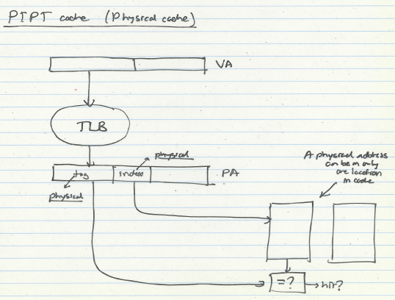
Physical Cache

Slide 37
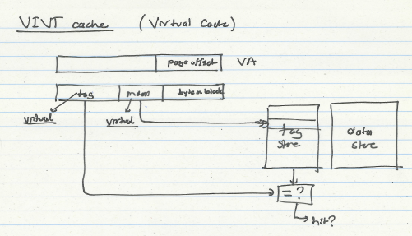
Virtual Cache

Slide 38
Virtually-Indexed Physically-Tagged
VPN
Page Offset
Index
BiB
TLB
physical
cache
PPN
=
tag
data
TLB hit?
cache hit?

Slide 39
Put it all together…
Physically indexed, physically tagged (PIPT)
  Wait for full address translation
  Then use physical address for both indexing and tag comparison
Virtually indexed, physically tagged (VIPT)
  Use portion of the virtual address for indexing then wait for address translation and use physical address for tag comparisons
  Easiest when index portion of virtual address w/in offset (page size) address bits, otherwise aliasing may occur
Virtually indexed, virtually tagged (VIVT)
  Use virtual address for both indexing and tagging…No TLB access unless cache miss
  Requires invalidation of cache lines on context switch or use of process ID as part of tags

Slide 40
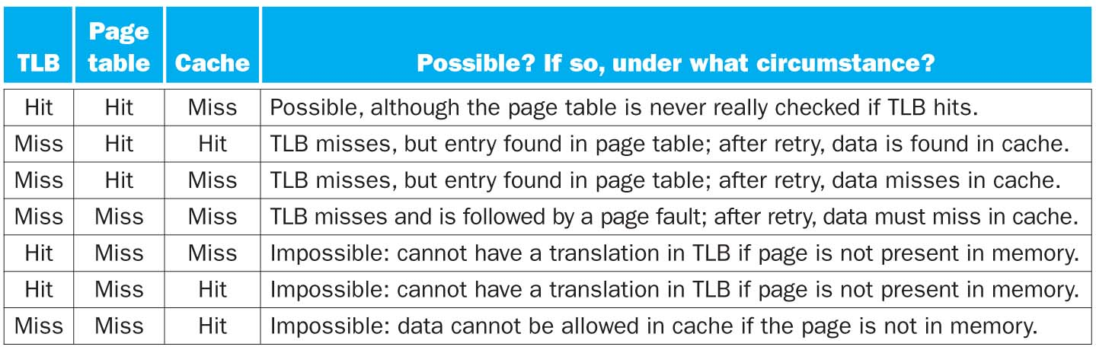
Cache & Virtual memory

Slide 41
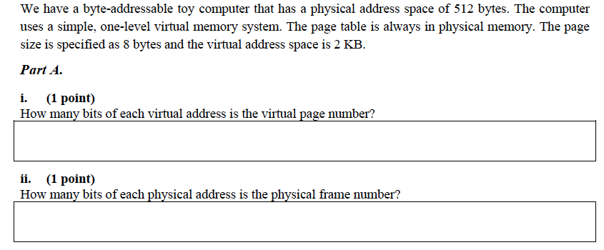
An Exercise

Slide 42
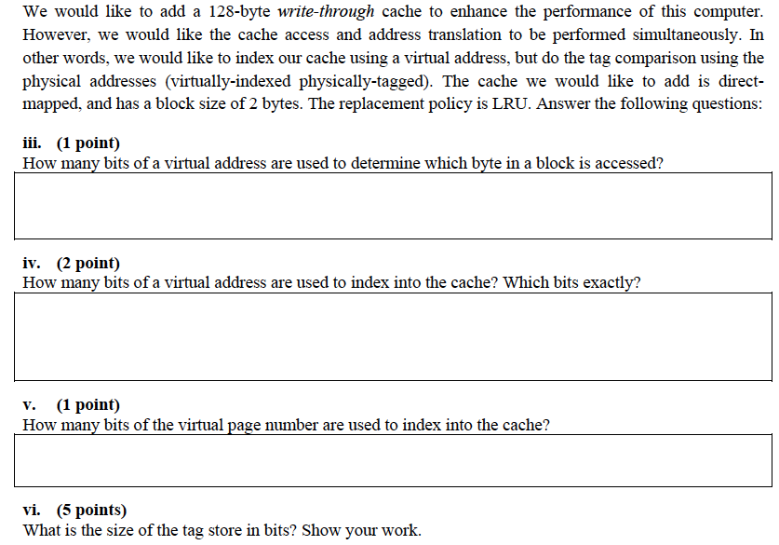
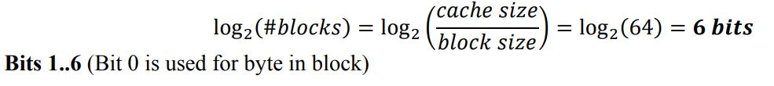
An Exercise (II)

Slide 43
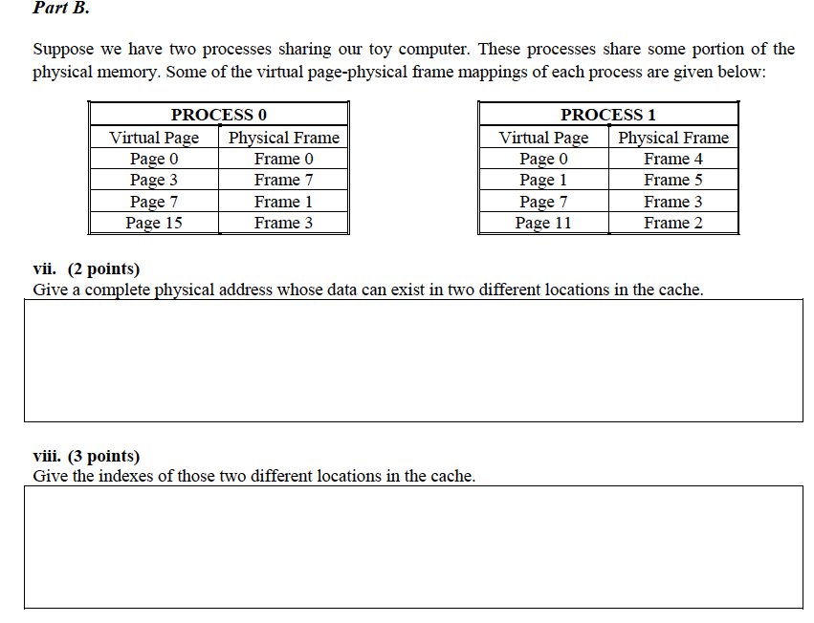

Slide 44
Summary
Virtual Memory overcomes main memory size limitations
VM supported through Page Tables
Multi-level Page Tables enables smaller page tables in memory
TLB enables fast address translation

